Slide 1

TAILORMADE
Dreamy Guys & Tech Team
K.L.N. College of Engineering
DEPARTMENT OF MCA

Slide 2
ABOUT AI:
Artificial Intelligence a.k.a., Machine Intelligence is the intelligence demonstrated by machines, like the natural intelligence shown by the human beings.
Artificial Intelligence primarily focuses on making intelligent machines that can assist and automate process. This is done with the help of certain Algorithms.
Artificial Intelligence is a way of making a computer, a computer-controlled robot, or a software think intelligently, in the similar manner the intelligent humans think.
Some of the activities of a computer with AI are designed for,
Speech recognition
Learning
Planning
Problem solving

Slide 3
ADVANTAGES OF USING AI:
A computer program with AI can answer the generic questions it is meant to solve.
AI programs can absorb new modifications by putting highly independent pieces of information together. Hence you can modify even a minute piece of information of program without affecting its structure.
Quick and Easy program modification.

Slide 4
PROBLEM DESCRIPTION:
“TAILORMADE” is a complex problem to accomplish within the short span of time. So, we the, “Dreamy Guys and Tech Team” have limited the topic to determine a suitable Shoe for the customers in Artificial Intelligence (AI) and Machine Learning (ML).
The Existing System, the customer has to go to the Shoe Shop and measure their size and choose their appropriate Shoe. This work gets more worse when there are various choices to choose from.

Slide 5
Cont..
In this topic “TAILORMADE”, we the students of K.L.N. COLLEGE OF ENGINEERING, have developed an efficient solution to this problem. We get the image of the customer’s feet by using ”Template Matching” and also predict the size of the object by using “ Pixel per Metric”. This can be applied for both Online and Offline.
Getting the Feet length from customer and give it to the trained AI.
Get shoe size from AI

Slide 6
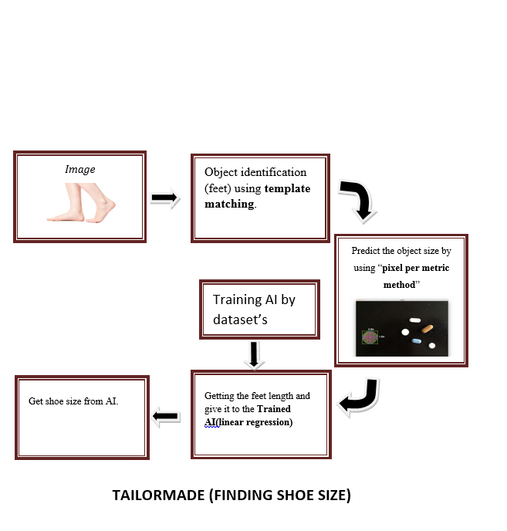
Block Diagram:

Slide 7
SAMPLE DATASET:
Foot Length (in cm) | Shoe Size
22.5 | 6
22.6 | 6
22.7 | 6
22.8 | 6.5
22.9 | 6.5
23 | 6.5
23.1 | 7
23.2 | 7
23.3 | 7
23.4 | 7
23.5 | 7.5
23.6 | 7.5
23.7 | 7.5
23.8 | 7.5
23.9 | 8
Foot Length (in cm) | Shoe Size
24 | 8
24.1 | 8
24.2 | 8
24.3 | 8.5
24.4 | 8.5
24.5 | 8.5
24.6 | 8.5
24.7 | 9
24.8 | 9
24.9 | 9
25 | 9
25.1 | 9.5
25.2 | 9.5
25.3 | 9.5
25.4 | 9.5
Foot Length (in cm) | Shoe Size
25.5 | 10
25.6 | 10
25.7 | 10
25.9 | 10
26 | 10.5
26.1 | 10.5
26.2 | 10.5
26.3 | 10.5
26.4 | 10.5
26.5 | 11
26.6 | 11
26.7 | 11
26.8 | 11
26.9 | 11
27 | 11.5

Slide 8
TEMPLATE MATCHING:
Template Matching is a method for searching and finding the location of a template image in a larger image.
OpenCV comes with a predefined function ”cv2.matchTemplate()” for this purpose.
It simply slides the template image over the input image and compares the template and patch of input image under the template image.
It returns a grayscale image, where each pixel denotes how much does the neighbourhood of that pixel match with template.

Slide 9
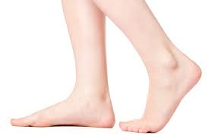

TEMPLATE MATCHING CODE:
import cv2
import numpy as np
from matplotlib import pyplot as plt
img = cv2.imread('download.jpg',0)
img2 = img.copy()
template = cv2.imread('template.jpg',0)
w, h = template.shape[::-1]
methods = ['cv2.TM_CCOEFF', 'cv2.TM_CCOEFF_NORMED', 'cv2.TM_CCORR', 'cv2.TM_CCORR_NORMED', 'cv2.TM_SQDIFF', 'cv2.TM_SQDIFF_NORMED']
Download.jpg
template.jpg

Slide 10
for meth in methods:
img = img2.copy()
method = eval(meth)
res = cv2.matchTemplate(img,template,method)
min_val, max_val, min_loc, max_loc = cv2.minMaxLoc(res)
if method in [cv2.TM_SQDIFF, cv2.TM_SQDIFF_NORMED]:
top_left = min_loc
else:
top_left = max_loc
bottom_right = (top_left[0] + w, top_left[1] + h)
cv2.rectangle(img,top_left, bottom_right, 255, 2)

Slide 11
plt.subplot(121),plt.imshow(res,cmap = 'gray')
plt.title('Matching Result'), plt.xticks([]), plt.yticks([])
plt.subplot(122),plt.imshow(img,cmap = 'gray')
plt.title('Detected Point'), plt.xticks([]), plt.yticks([])
plt.suptitle(meth)
plt.show()

Slide 12
Measuring the size of an object (Pixel per Metric):
Measuring the size of objects in an image is similar to computing the distance from our camera to an object - in both cases, we need to define a ratio that measures the number of pixels per a given metric.
The “pixels per metric” ratio
In order to determine the size of an object in an image, we first need to perform a “calibration” (not to be confused with intrinsic/extrinsic calibration) using a reference object.

Slide 13
Our reference object should have two important properties:
Property #1: We should know the dimensions of this object (in terms of width or height) in a measurable unit (such as millimeters, inches, etc.).
Property #2: We should be able to easily find this reference object in an image, either based on the placement of the object (such as the reference object always being placed in the top-left corner of an image) or via appearances (like being a distinctive color or shape, unique and different from all other objects in the image). In either case, our reference should be uniquely identifiable in some manner.

Slide 14
REGRESSION:
Data can be smoothed by fitting the data to a function, such as with regression.
Types of regression:
Linear Regression
Multi Linear Regression
Linear Regression involves finding the “best” line to fit two variables, so that one variable can be used to predict the other.
Multiple Linear Regression is an extension of linear regression, where more than two variables are involved and the data are fit to multidimensional surface.

Slide 15
CODE FOR LINEAR REGRESSION :
import numpy as np
import matplotlib.pyplot as plt
def estimate_coef(x, y):
n = np.size(x)
m_x, m_y = np.mean(x), np.mean(y)
SS_xy = np.sum(y*x - n*m_y*m_x)
SS_xx = np.sum(x*x - n*m_x*m_x)
b_1 = SS_xy / SS_xx
b_0 = m_y - b_1*m_x
return(b_0, b_1)

Slide 16
def main():
feet_size = np.array([22.5,22.6,22.7,22.8,23, 23.5, 23.8, 24, 24.6, 25, 25.4, 25.9, 26.2])
shoe_size = np.array([6,6, 6,6,6.5, 7, 7.5, 8, 8.5, 9, 9.5, 10, 10.5])
co_ef = estimate_coef(feet_size,shoe_size)
print("Estimated coefficients:\nb_0 = {}\nb_1 = {}".format(co_ef[0], co_ef[1]))
print("Sample Feet Size")
sample_size=22.5#sample feet size
a_o=co_ef[1]*sample_size+co_ef[0]#actual output
print(a_o)
if __name__ == "__main__":
main()

Slide 17

OUTPUT:

Slide 18
THANK YOU !!!!!!

